Slide 1

Data Exploration, Preparation, and Predictive Modeling for Customer Bookings

Slide 2
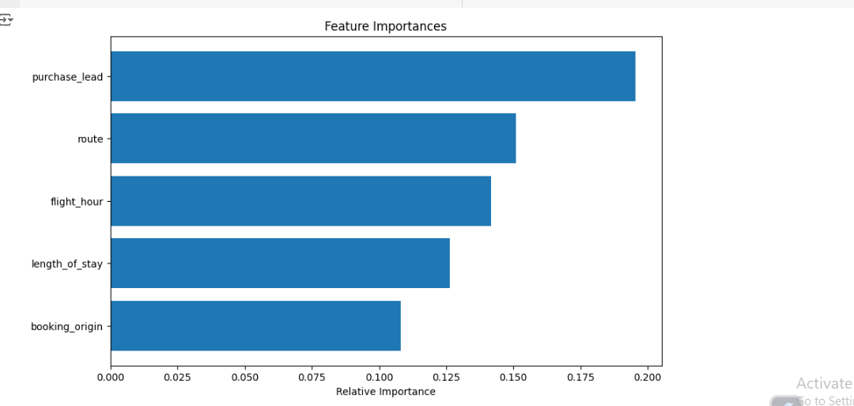
Summary of finding
The analysis identified 'purchase lead time,' 'route,' 'flight hour,' 'length of stay,' and 'booking origin' as key factors in customer behavior, achieving an 85.2% accuracy with a Random Forest classifier. These insights enable airlines to refine marketing strategies and personalize customer interactions. This proactive approach enhances the ability to predict and influence holiday bookings effectively.

